Slide 1
Effectiveness of adversarial examples on convolutional neural networks
Presented by
Rafael Possas,
Research Engineer at Centre of Translational Data Science, University of Sydney
Master of Information Technologies (Research)

Slide 2
Contents
Concepts
Motivation
Research Question
Contributions
Experiment design
Results
Conclusion

Slide 3
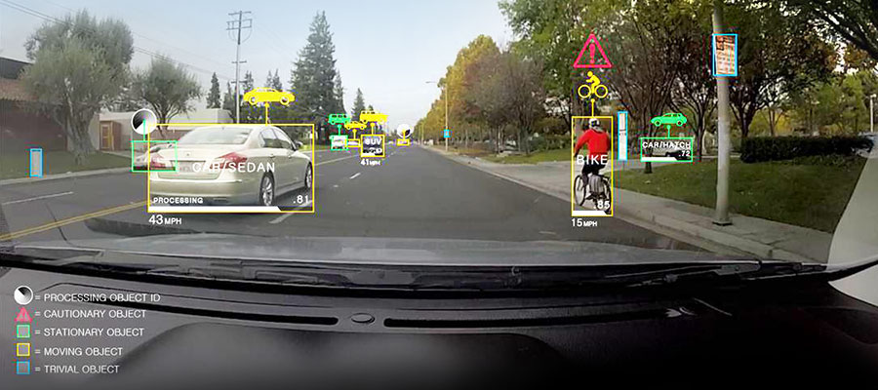
What is Computer vision?
“ Computer vision is an interdisciplinary field that deals with how computers can be made to gain high-level understanding from digital images or videos” - Wikipedia
Example of object segmentation on a self-driving car [1]

Slide 4

Convolutional neural networks
“Type of feed-forward neural network which the connectivity pattern is inspired by the organization of the animal visual cortex” [2]
It provides state of the art performance on data with spatial structure [1].
An example of CNN architecture, VGGNet [3]

Slide 5
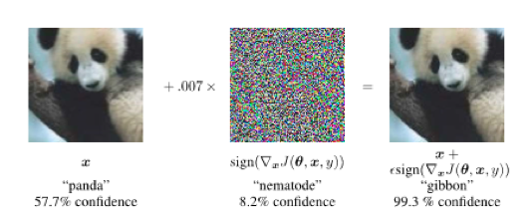
Adversarial inputs
Intentional modification on inputs to deliberately yield erroneous model outputs, while appearing unmodified to human observers.
Depend on model information to successfully generate an adversary
Adversarial crafting using Gradient Sign from Goodfellow et al. (2014) [3]

Slide 6
Imbalanced learning and domain shift
Imbalanced Learning: When the underlying training set contains high variance on the number of samples for each class.
Domain Shift: When the joint distributions of inputs and outputs differs between training and test stages.
Imbalanced Learning
Domain Shift
enforces

Slide 7

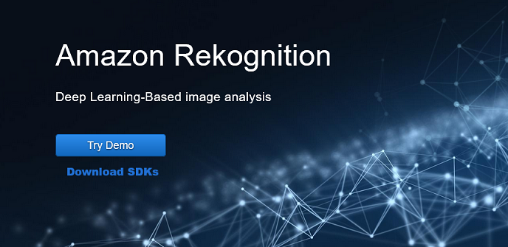
Motivation
Image recognition systems have been used widely in commercial applications
Adversarial attacks are proven to work on state of the art convolutional neural networks (CNNs) architectures.
Real world data is often imbalanced with lots of missing values
There is no empirical evidence of adversarial attacks on class-imbalanced CNNs

Slide 8
Research question
Would adversarial attacks be more effective on networks trained on Imbalanced datasets?
Does the attacks heavily depend on the targeted model internal knowledge?
Does classes with similar and different features space behave equally to adversarial attacks?

Slide 9
Contributions
Evaluation of the resilience of imbalanced CNNs to adversarial attacks using the white-box and black-box approach
Investigation of classes with overlapping distributions and their relationship to both adversarial attacks and imbalanced learning problem

Slide 10
Experiment design (1): CNN Architecture
First architecture to show that the depth of a network its critical to its performance
Homogeneous architecture: Only 3x3 convolutions and 2x2 pooling from beginning to end
We’ve changed the architecture to cope with the smaller input size (32x32).
Change: Two 4096 FC => single 512 FC layer
Change: 3 Convolution/pooling blocks instead of 4.

Slide 11
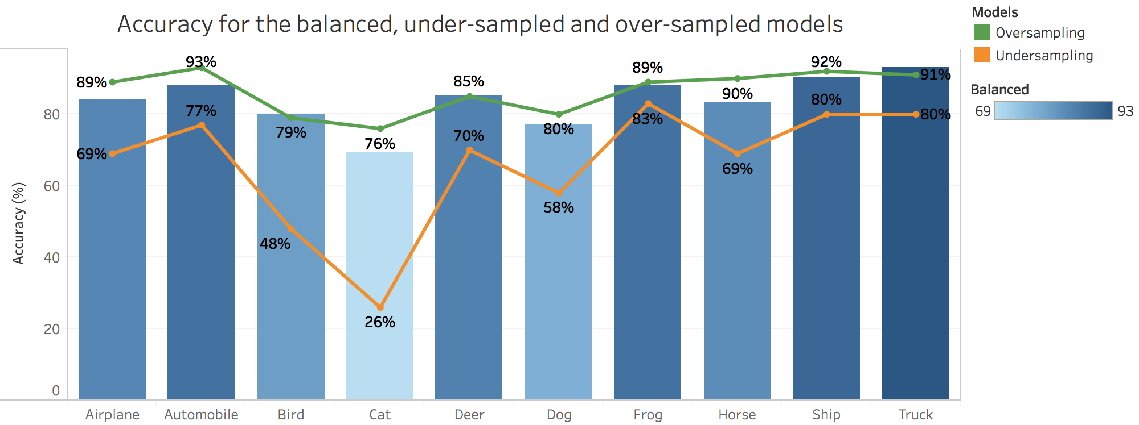
Experiment design (2): Imbalanced dataset
CIFAR-10, 32x32 images on 10 non-hierarchical classes, 60,000 samples
Modified VGG: achieved 83% overall accuracy on the balanced dataset
Baseline: Balanced dataset vulnerability to adversaries
Tests: 20 different imbalanced variations with under-sample and over-sample on each of the 10 classes

Slide 12
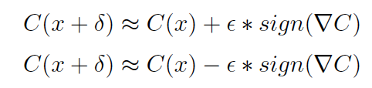
Experiment design (3): Gradient sign method [4]
Uses the gradient of any chosen class to add small noise to image pixels
Only the gradient direction is used due to the sign operation, the magnitude of the perturbation is controlled by the epsilon
Fast gradient sign x Iterative gradient sign [4]
Ascent x Descent perturbations
Epsilon 0.01: Best trade-off between misclassification and image noise
Methods: Fast gradient sign and ascent perturbations
Backpropagated gradient: True class
Intuition: Increase the cost function of the true class by the epsilon value in all gradient directions

Slide 13
Experiment design (4): White/Black-box attacks
Same model gradient (White-box): Uses the underlying model knowledge to create optimal perturbations
Different model gradient (Black-box): Uses an approximation of the true model, in this experiment, represented by the balanced network.
Same data domain but datasets vary on the total number of samples.

Slide 14
Experiment workflow
Create synthetic imbalanced datasets
Train models on imbalanced data
Generate adversaries with the described combinations
Evaluate adversarial attacks effectiveness on all models

Slide 15
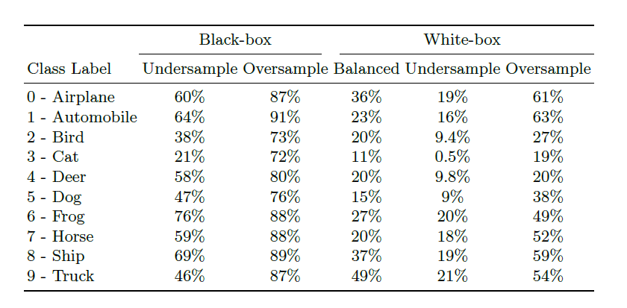
Results (1): Overall accuracy
While the over-sampled models were more robust to adversaries, the under-sampled models had lower overall accuracy
White-box attacks were generally more efficient than black-box attacks

Slide 16
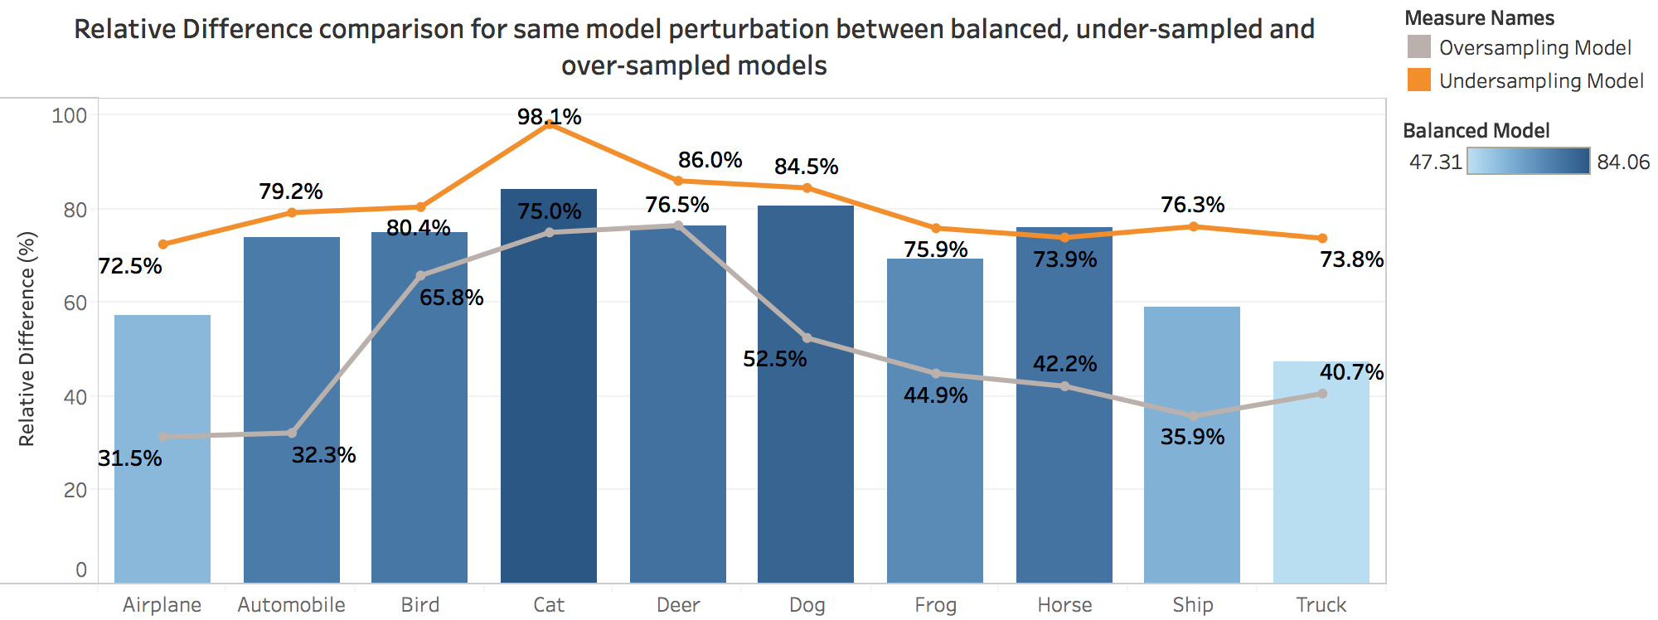
Results (2): Relative difference on white-box attacks
We calculated the percentage difference between the non-perturbed and perturbed model – the graph shows the results for the 3 variations on the white-box attack – Higher values means more vulnerable

Slide 17
Results (3): Relative difference insights
The Cat class relative difference was the highest due to the low score of 0.5% on the under-sampled dataset.
Deer class relative difference seemed to be the same on the balanced and over-sampled, which shows that the samples in the dataset might provide good representation, therefore, generalisation can occur irrespective of the number of training inputs.
The horse class shows an interesting result as the under-sampling was the only one with a better performance than the balanced case.

Slide 18
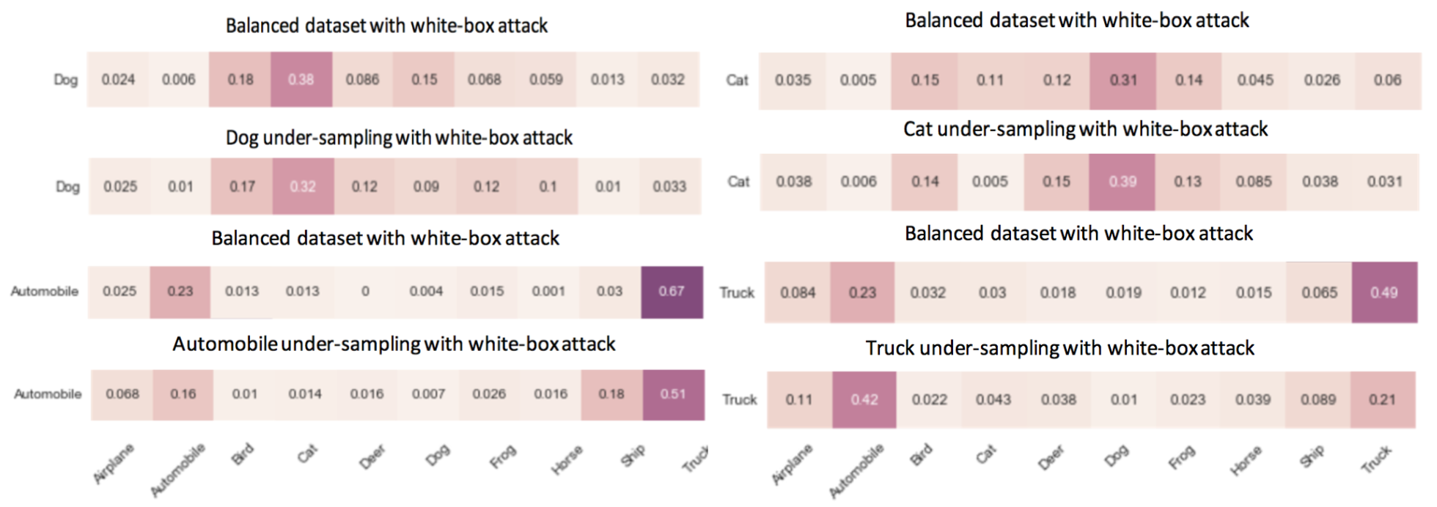
Results (4): Overlapping distributions
Classes with similar features are often misclassified as one another
Stronger Classes
Weaker Classes

Slide 19
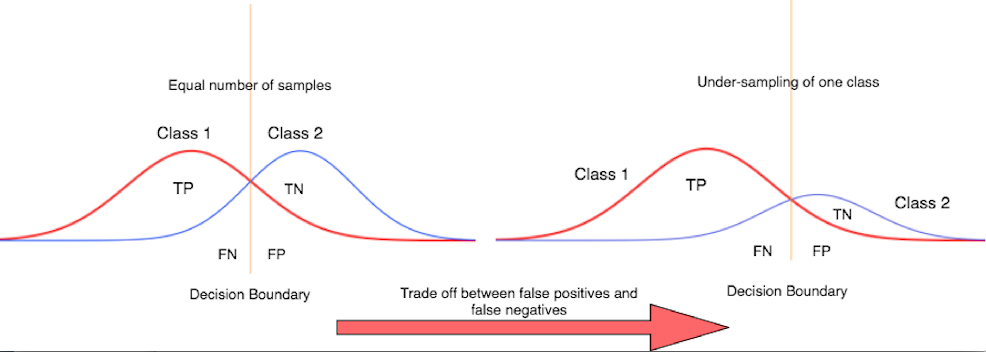
Results (5): Decision boundary bias
Data imbalance causes a natural trade-off between over-sampled and under-sampled labels

Slide 20
Conclusions
Under-sampled networks are more vulnerable to adversarial attacks while over-sampling increase robustness
Black-box attacks are less effective than white-box which shows that gradients learned differs greatly even if we use the same data domain
On the white-box attack with under-sampled training set, the non-dominant class was misclassified more often as the dominant class (overlapping distributions).
CNNs shows linear behavior in high-dimensional spaces

Slide 21
Future Work?
Use datasets with more classes
Try different gradient sign methods with different combinations of epsilon values
Do adversarial attacks are less or more vulnerable on different CNNs architectures?

Slide 22
References
1. Goodfellow, I.J, Bengio, Y. and Courville, A. Deep learning. Book in preparation for MIT Press, 2016.
2. Lawrence, S., Giles, C.L., Tsoi, A.C., Back, A.D.: Face recognition: A convolutional neural-network approach. IEEE transactions on neural networks 8(1), 98{113 (1997)
3. Simonyan, K., Zisserman, A.: Very deep convolutional networks for large-scale image recognition. arXiv preprint arXiv:1409.1556
4. Goodfellow, I.J., Shlens, J., Szegedy, C.: Explaining and harnessing adversarial, examples. arXiv preprint arXiv:1412.6572 (2014)
(2014)

Slide 23
Questions?

